Slide 1

HOME
CONTENTS
CONTRIBUTORS
Convolutional Neural Networks in Tensorflow
GET STARTED

Slide 2

HOME
CONTENTS
CONTRIBUTORS
NGUYỄN THÀNH VINH
18521654
VinhDevNguyen/CNN_in_Tensorflow

Slide 3
HOME
CONTENTS
CONTRIBUTORS
INTRODUCE LARGE DATASET
TRAINING WITH DATASET
WORKING WITH NOTEBOOK
FIXING THROUGH CROPPING
LOOKING AT LOSS AND ACC.

Slide 4

INTRODUCE LARGE DATASET

Slide 5
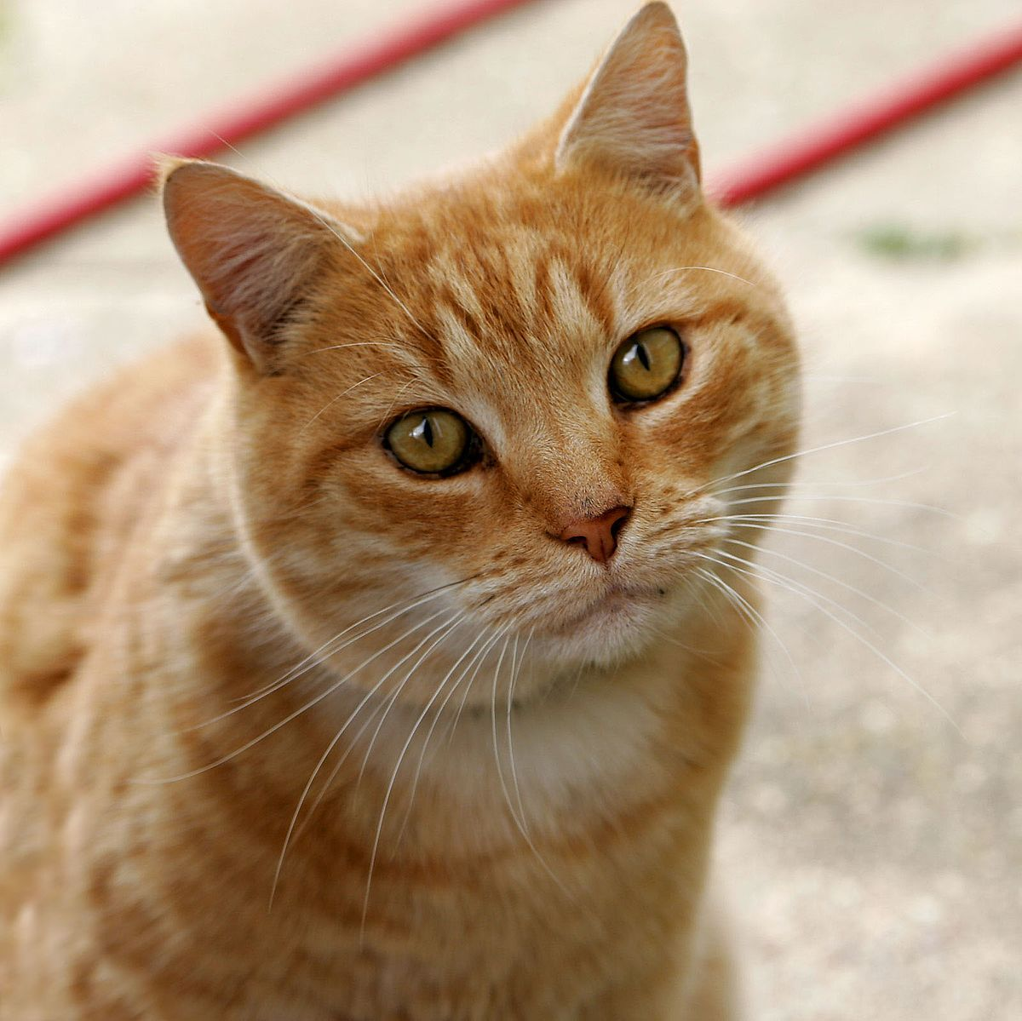
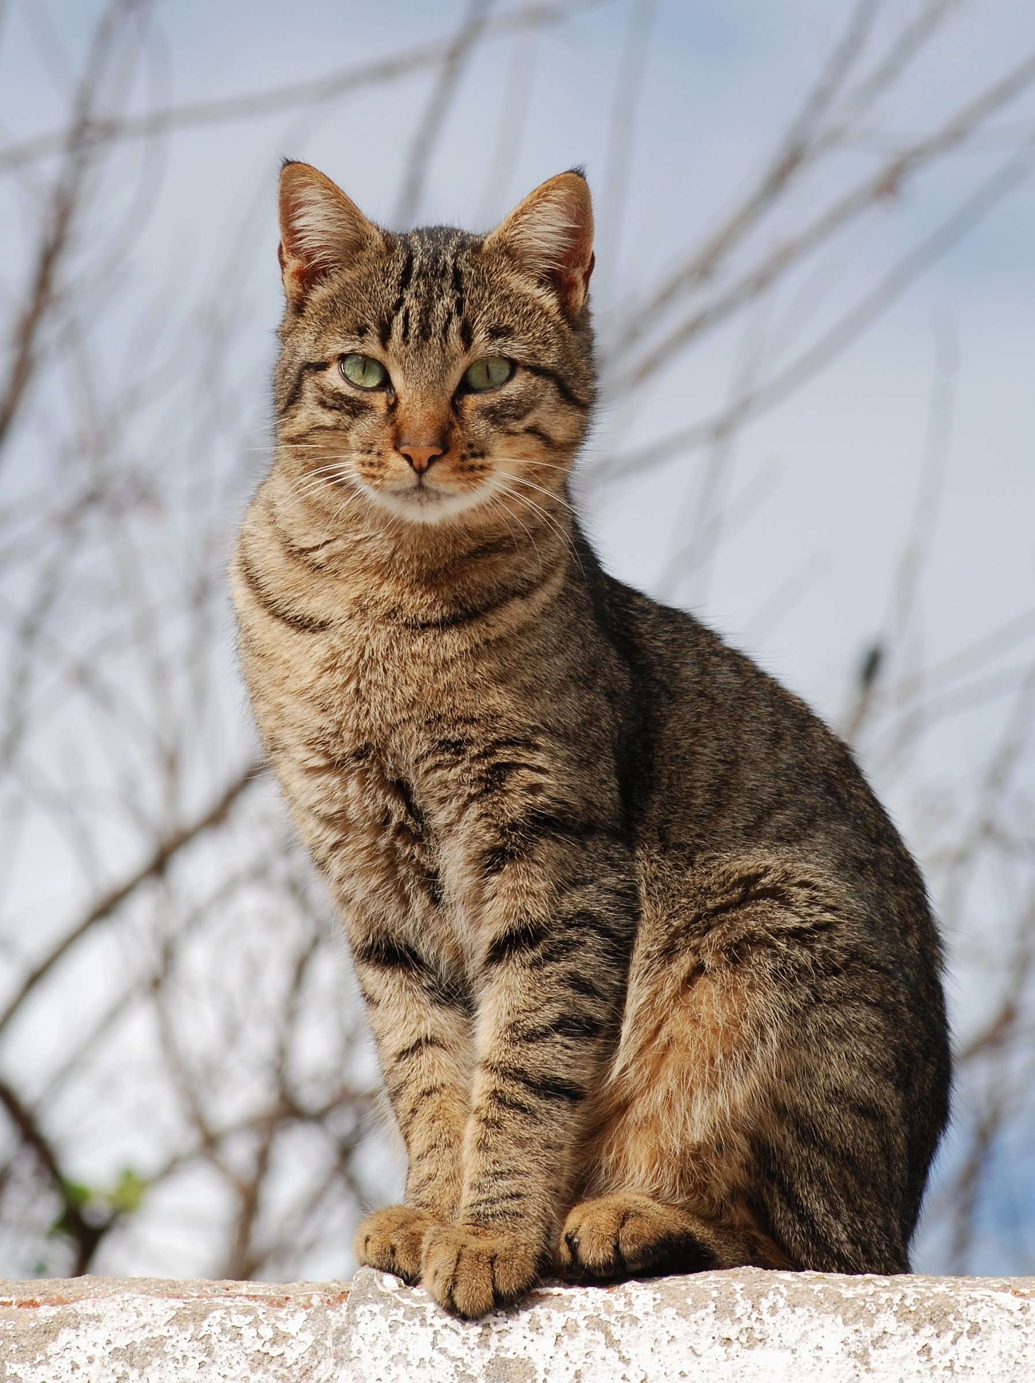
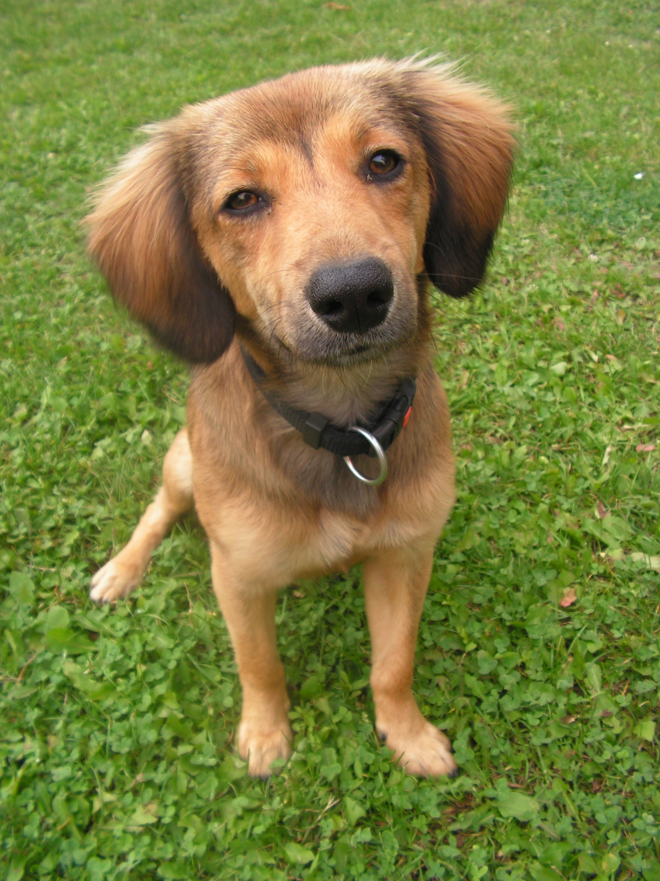
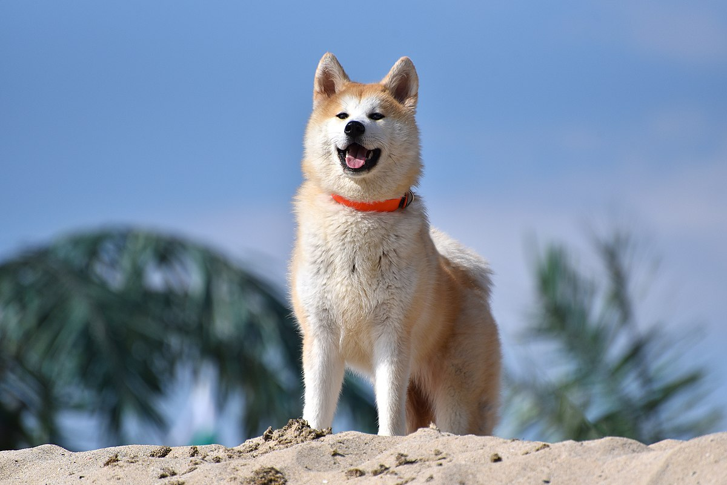
Public dataset (cats vs dogs)

Slide 6

Data is messy

Slide 7
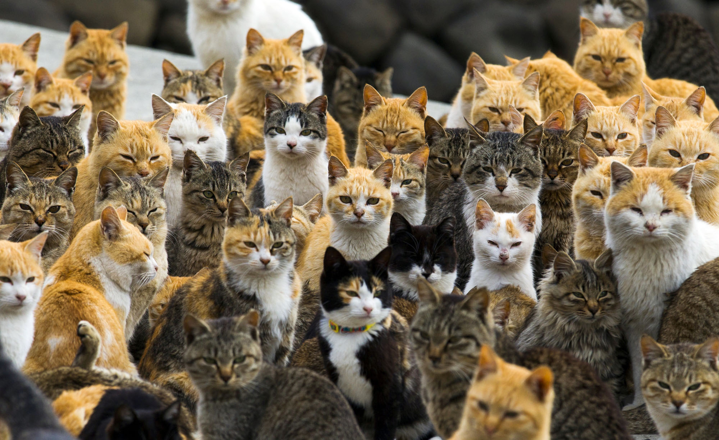
Data is messy

Slide 8

Data is messy

Slide 9
Data is messy
Nothing???

Slide 10
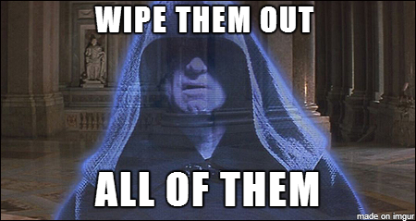
Data is messy
Use your Python skill

Slide 11

Messy data
Notes:
We are going to use clean dataset But we are going to hit some of those issues above
Using these skill will able to deal with other datasets that may not be as clean as this one

Slide 12

Write something
Write something

